Slide 1

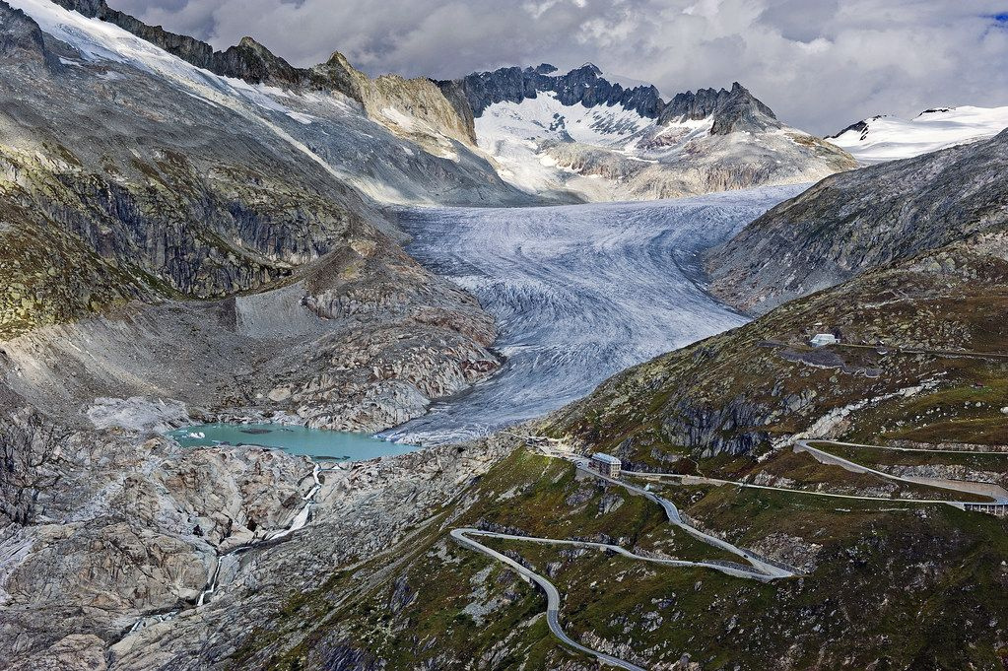

SENTINEL PROJECT
  Simone Maria Mazzola
  Paolo Ginefra
  Matteo Gandini
  Jacopo Sampò
  Shahd Abdelaziz
  Aronne Moltrasio
  Nicolò Dalmazzo
ASP
XXI cycle
Professors:
  Carlo De Michele
  Alberto bianchi
  Livio pinto
  Alberto Cina
Notes:
"How confident are you in this diagnosis?"
What is a simple routine exchange between two doctors, for the patient could mean months of waiting or uncertainty.
In ALS - Amiotrophic Lateral Scleroris- diagnosis, the stakes couldn't be higher, but the problem isn't neurologist expertise. The problem is the signal itself.

Slide 2

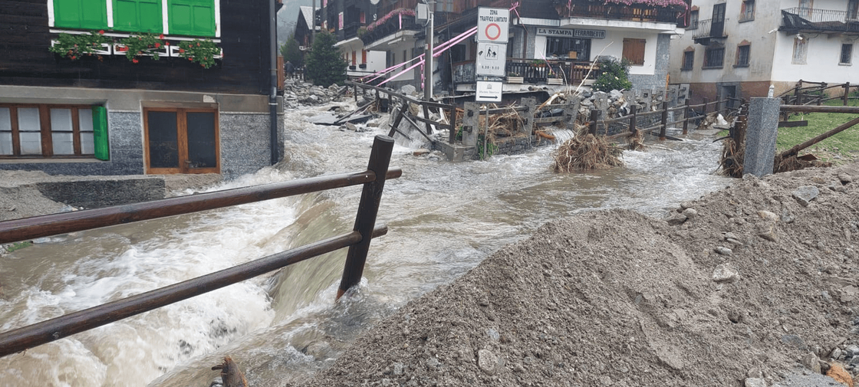
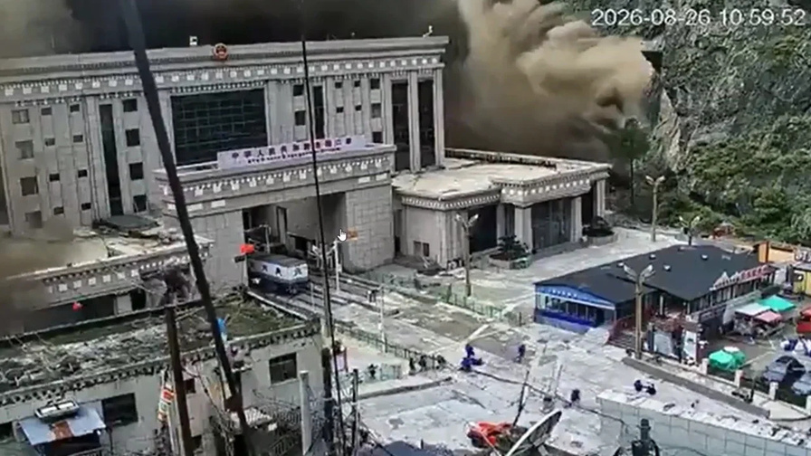
The Problem
Climate change
Glacier retreat
Destabilization of mountain slopes
Macugnaga flood 2024
Rapid mobilization of sediment volumes and hazardous events
Damages to resources
Risk for people
Nepal flood tragedy 27/08/2026 ~ 392 Deaths
2
Notes:
SEPs are electrical signals that show how efficiently information travels from the body to the brain.
While they carry crucial diagnostic information for ALS detection, their interpretation is far from straightforward.
Neurologists face:
elencare problemi seps
Result (problemi diagnosi sla): Inconsistent diagnoses, missed cases, and diagnostic uncertainty when certainty is medically necessary.
"What if we could replace subjective interpretation with objective, consistent feature extraction? And what if ML could bring certainty back into ALS diagnosis?"

Slide 3
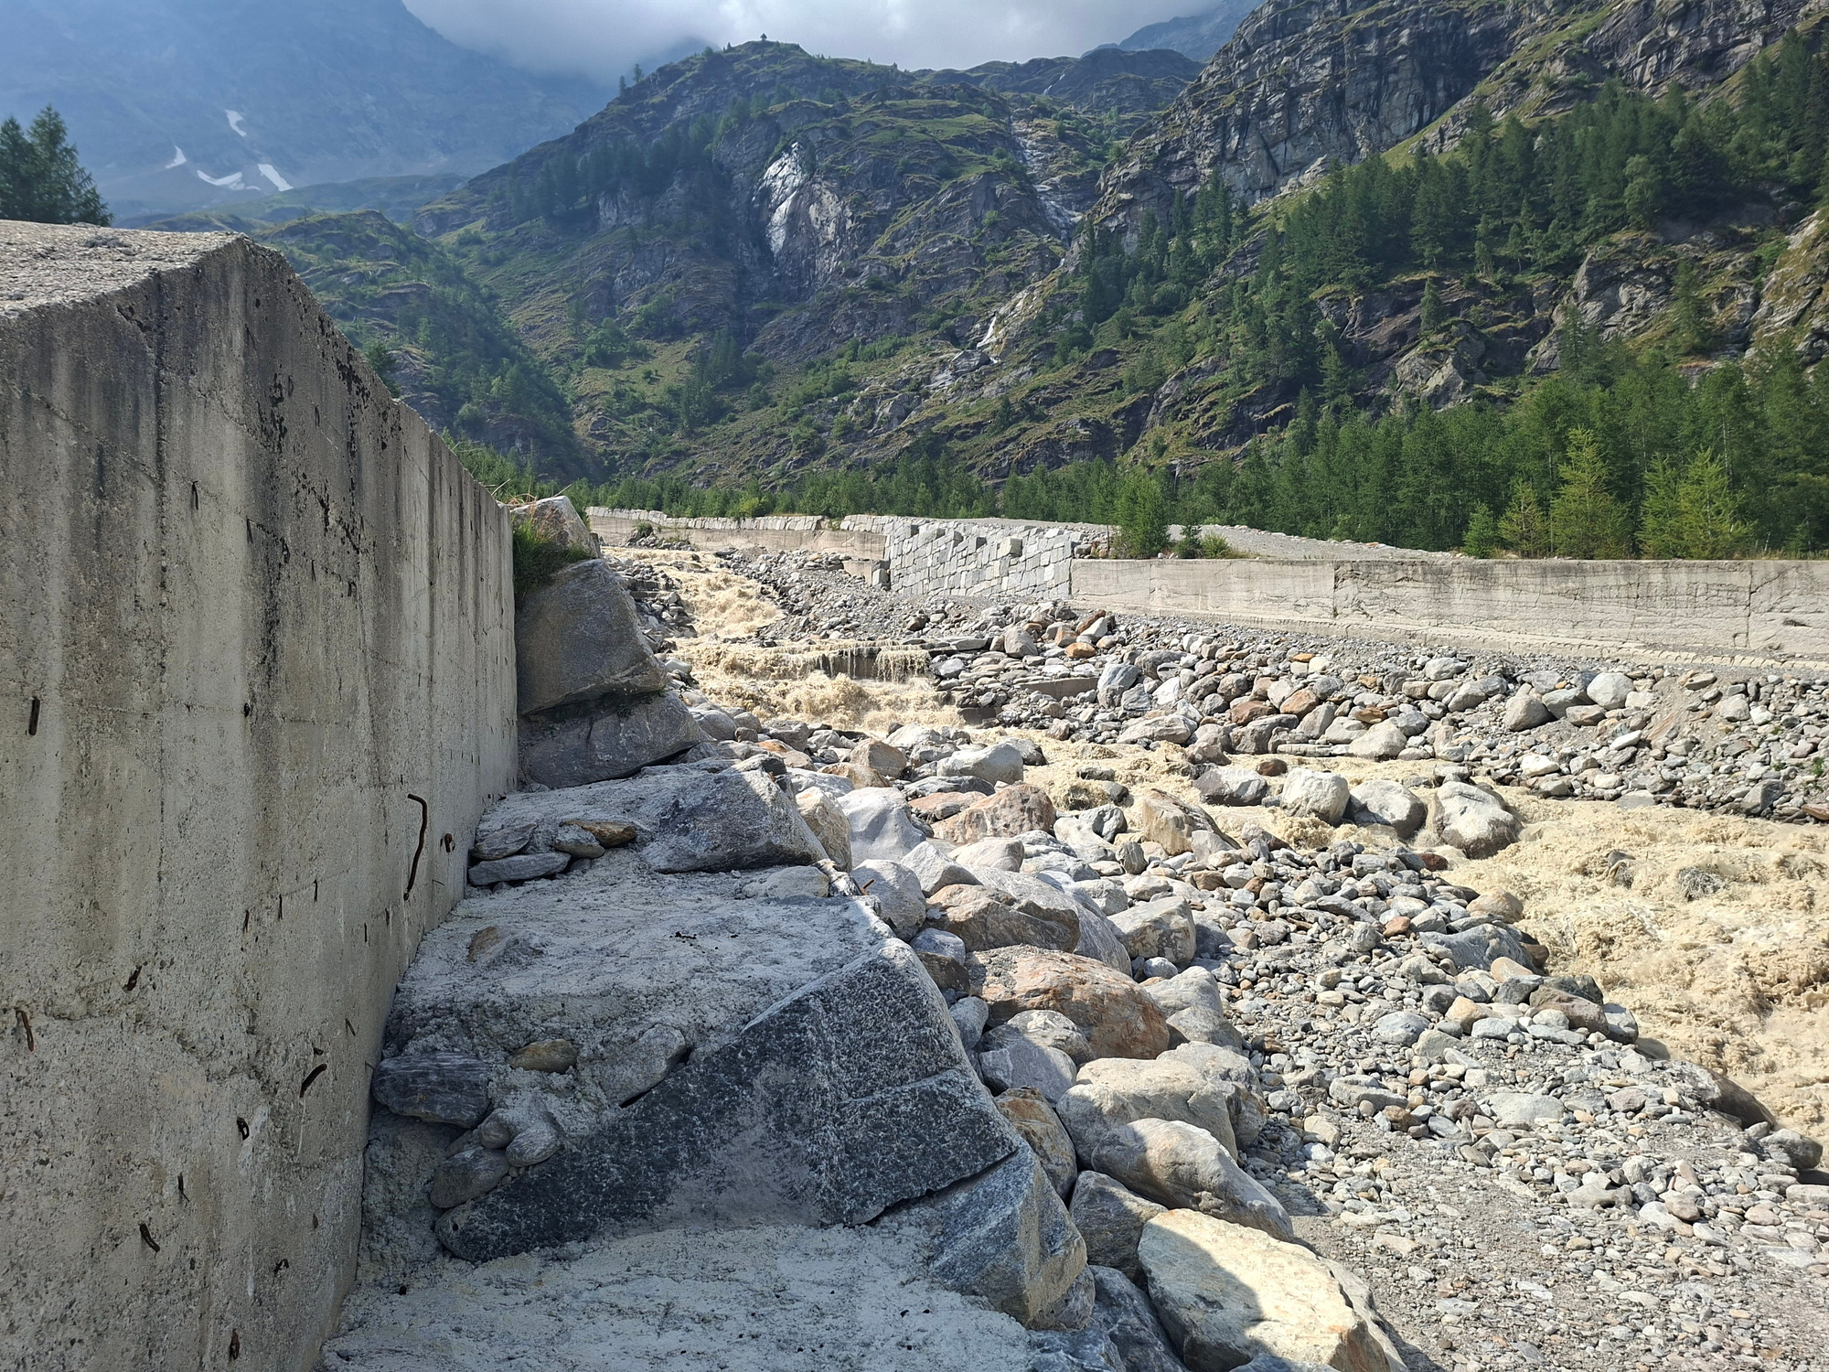
The Monitoring Challenge
Extreme Weather Condition
No Grid Connection
Rockfall Risk
Remote and Hazardous Location
High Quality Images / data
3
Installation site
Notes:
SEPs are electrical signals that show how efficiently information travels from the body to the brain.
While they carry crucial diagnostic information for ALS detection, their interpretation is far from straightforward.
Neurologists face:
elencare problemi seps
Result (problemi diagnosi sla): Inconsistent diagnoses, missed cases, and diagnostic uncertainty when certainty is medically necessary.
"What if we could replace subjective interpretation with objective, consistent feature extraction? And what if ML could bring certainty back into ALS diagnosis?"

Slide 4
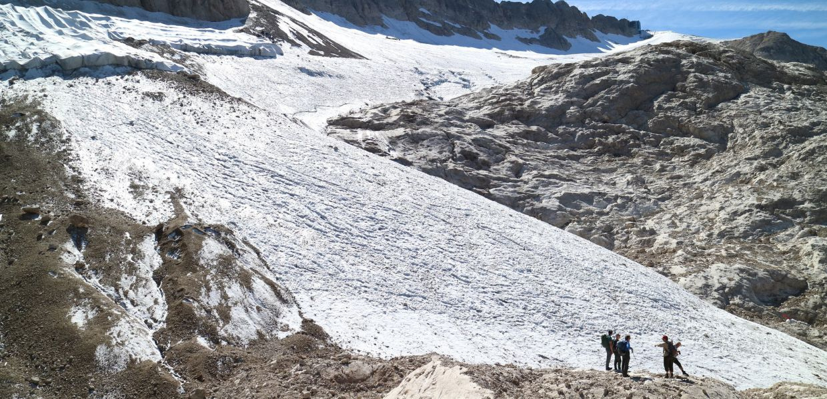
Current Limitations
The problem is not the lack of monitoring technologies, it is the lack of continuous, reliable observations
Continuity
  Saltuary monitoring campaigns
  No mapping of phenomena’s evolution
  Impossibility to record sudden events
Reliability
  Cloud interfearance
  Inconsistently reported data
  Restricted sampling
Marmolada glacier survey expedition
4
Notes:
SEPs are electrical signals that show how efficiently information travels from the body to the brain.
While they carry crucial diagnostic information for ALS detection, their interpretation is far from straightforward.
Neurologists face:
elencare problemi seps
Result (problemi diagnosi sla): Inconsistent diagnoses, missed cases, and diagnostic uncertainty when certainty is medically necessary.
"What if we could replace subjective interpretation with objective, consistent feature extraction? And what if ML could bring certainty back into ALS diagnosis?"

Slide 5




Objective
Goal: Develop an autonomous optical monitoring system to continuously observe glacier-fed rivers and estimate water turbidity from remote imagery.
Design of autonomous and continuous observation system for glacier-fed river.
Monitoring Platform Design
Quantitative Information Pipeline Implementation
ML pipeline for quantitative information extraction on water turbidity.
Integrated Platform Deployment
Development, installation and commissioning of the validated phisical monitoring platform.
5
Notes:
SEPs are electrical signals that show how efficiently information travels from the body to the brain.
While they carry crucial diagnostic information for ALS detection, their interpretation is far from straightforward.
Neurologists face:
elencare problemi seps
Result (problemi diagnosi sla): Inconsistent diagnoses, missed cases, and diagnostic uncertainty when certainty is medically necessary.
"What if we could replace subjective interpretation with objective, consistent feature extraction? And what if ML could bring certainty back into ALS diagnosis?"

Slide 6
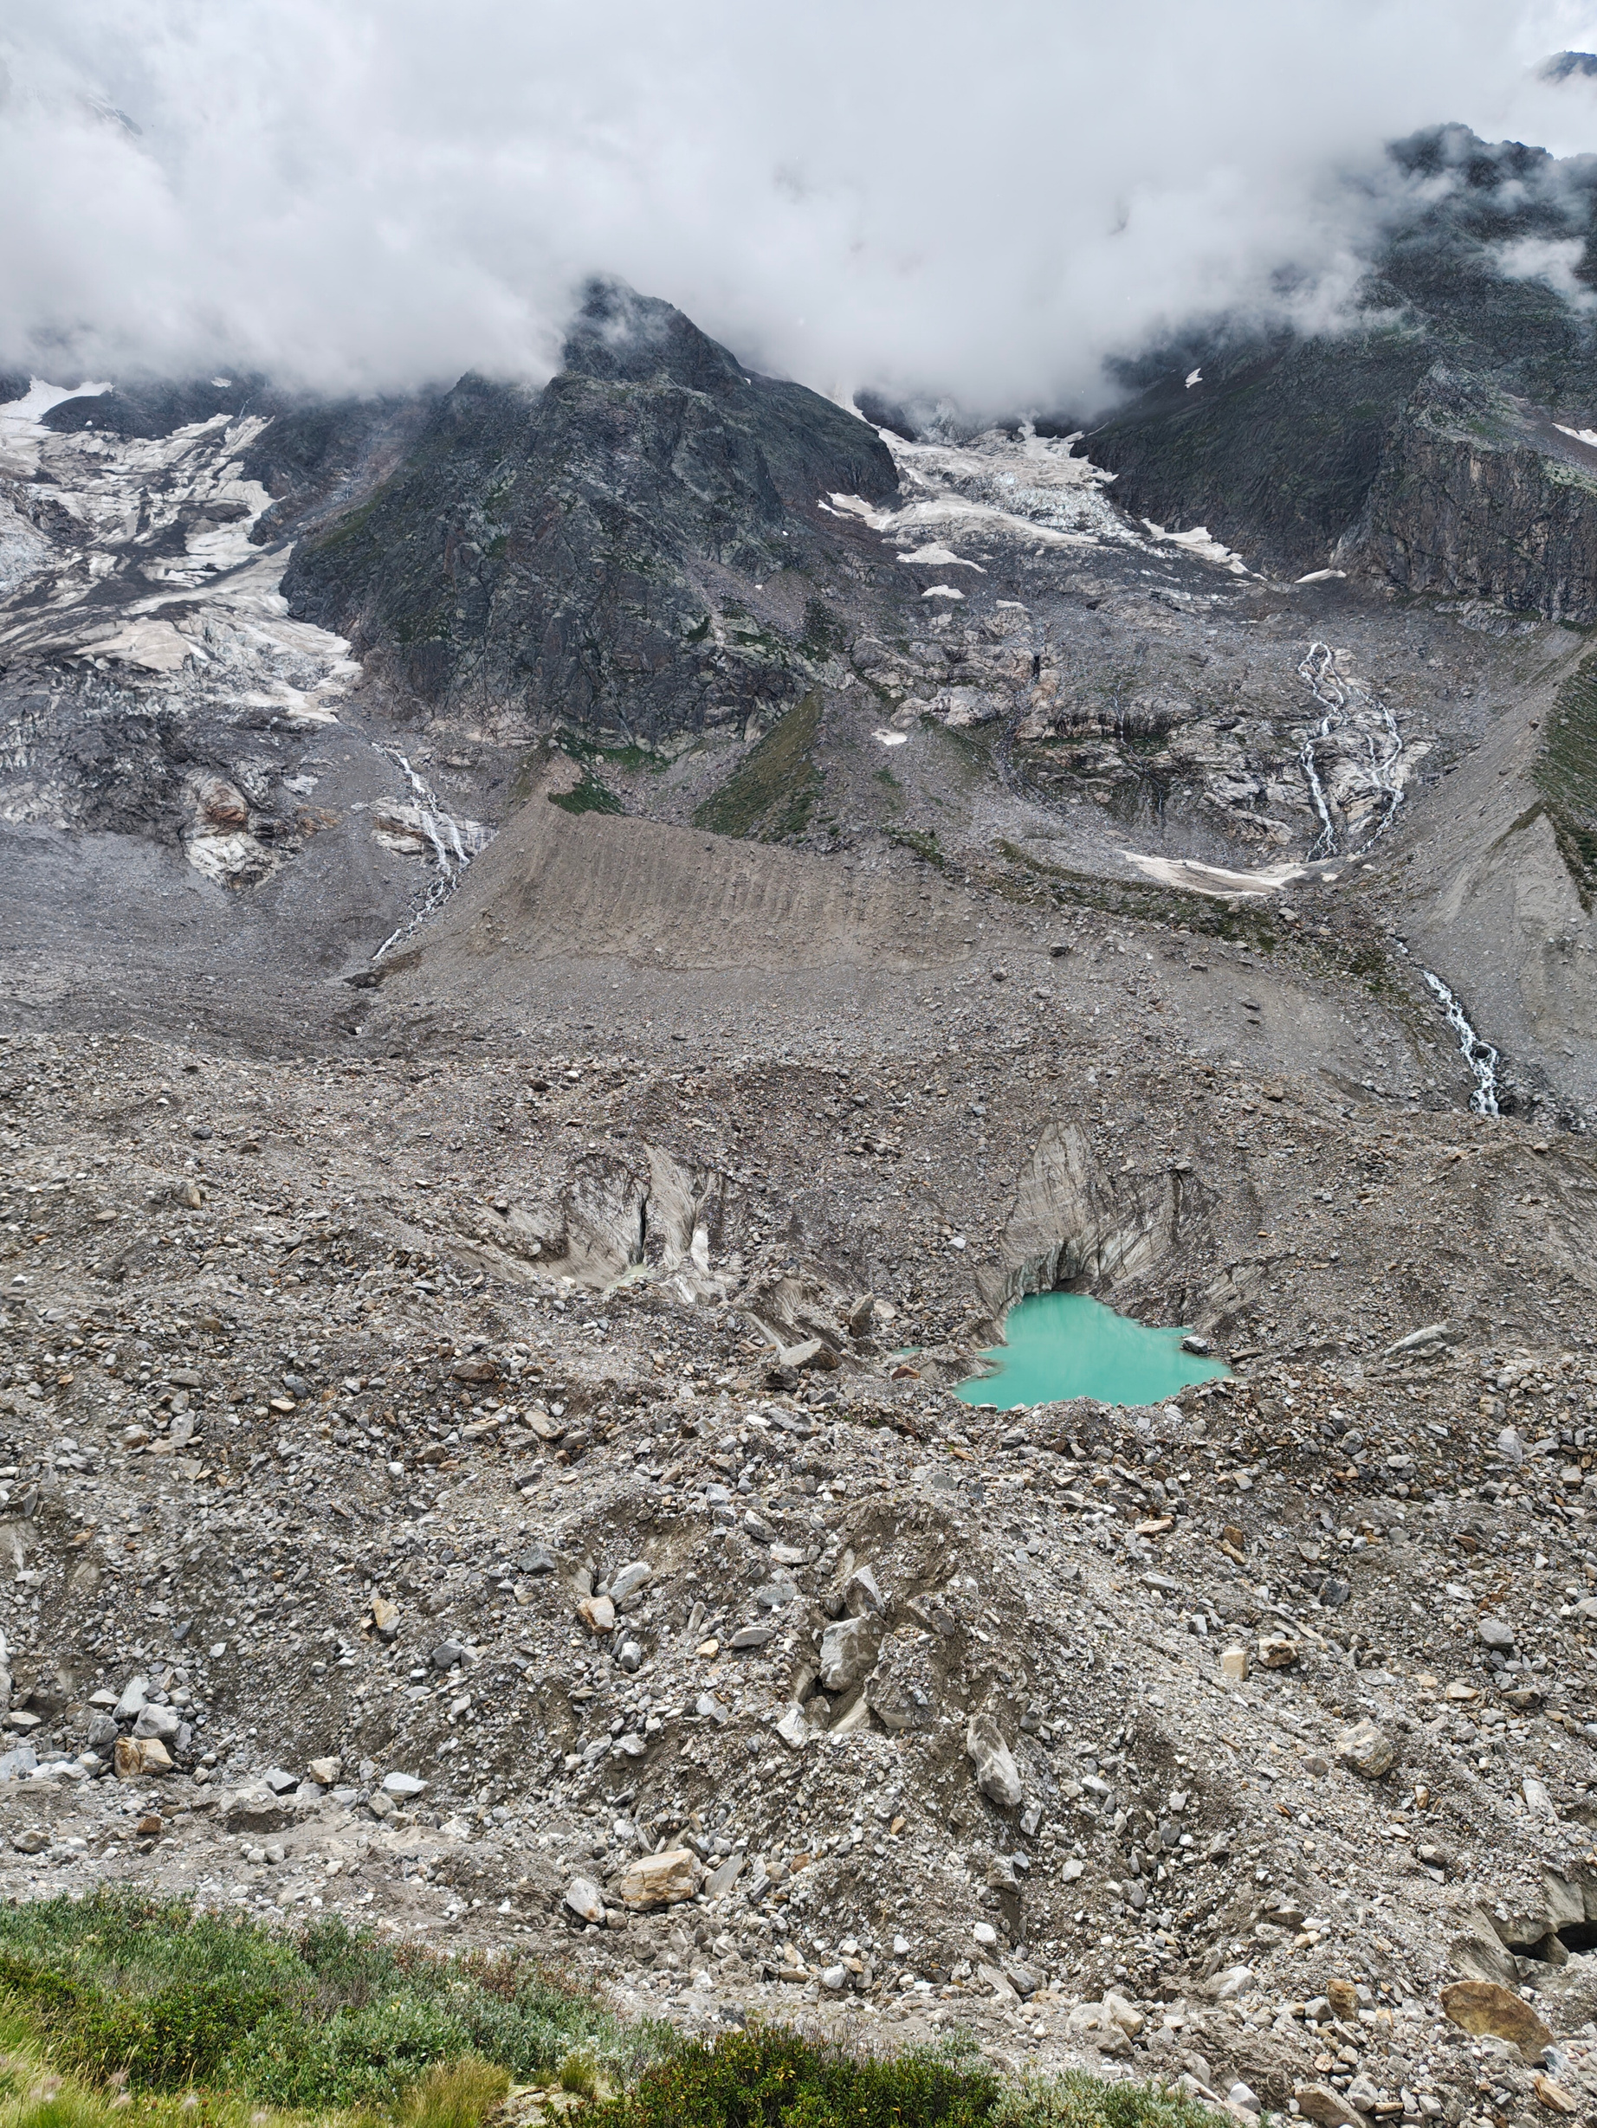
Case Study
Belvedere glacier
6
Notes:
SEPs are electrical signals that show how efficiently information travels from the body to the brain.
While they carry crucial diagnostic information for ALS detection, their interpretation is far from straightforward.
Neurologists face:
elencare problemi seps
Result (problemi diagnosi sla): Inconsistent diagnoses, missed cases, and diagnostic uncertainty when certainty is medically necessary.
"What if we could replace subjective interpretation with objective, consistent feature extraction? And what if ML could bring certainty back into ALS diagnosis?"

Slide 7
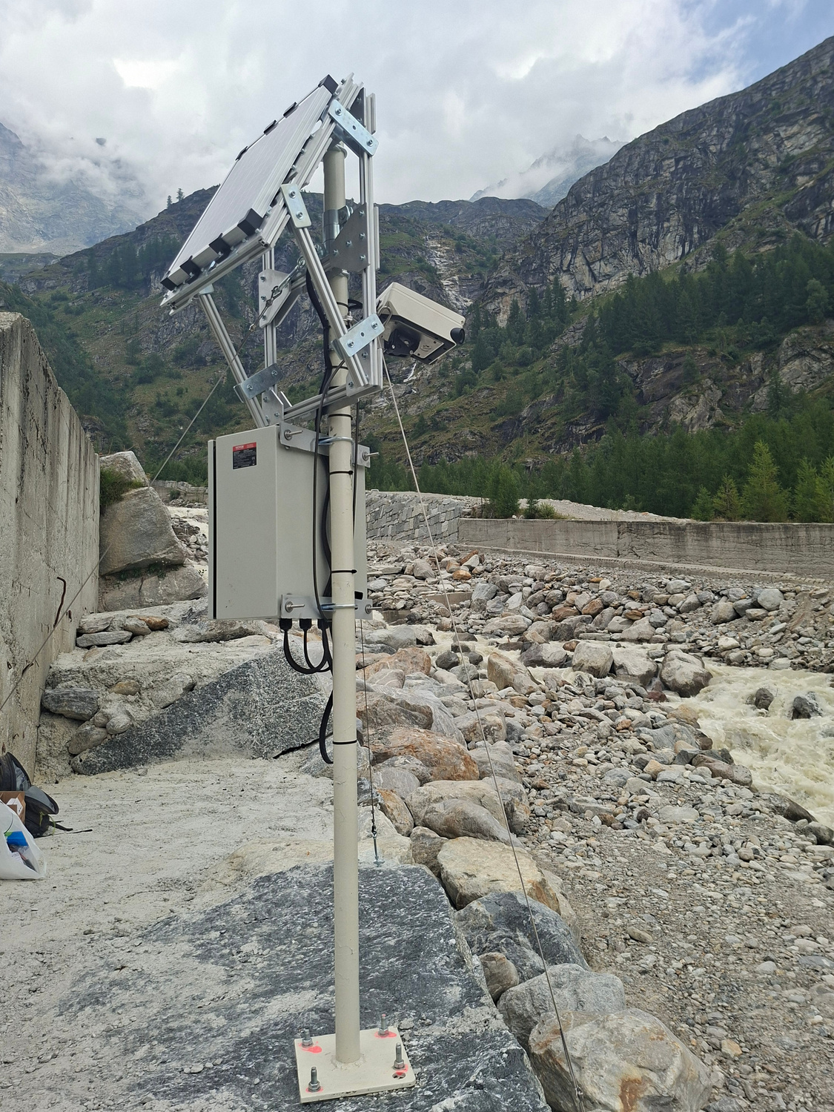
Requirements
Basic Fit
Vigilant
  Continous monitoring
  Adequate spatial coverage
  Sufficient image resolution
Autonomous
  Long term operation
  No external power source
Connective
  Automatic image transmission
  Remote data availability
Robust
7
  Low maintenance
Commissioned on site solution
Notes:
Introducing ALSense — a platform designed to transform complex clinical data into clear, actionable insights.
ALSense was built with clinicians in mind: simple, intuitive, and immediately usable.
The user can upload data in just a few steps, without manual preprocessing or subjective interpretation.
From that moment on, the system takes over — analyzing the signal automatically and objectively. This is where ALSense begins to differentiate itself: by removing variability and uncertainty from the very first interaction

Slide 8
Case Study Targets
Basic Fit
Riverbed width
Ground resolution
16 m
1 cm/px
Width between riverbanks, regardless of water level
Target ground resolution required for data extraction
Acquisition interval
Long term
15 Min
Multi-year
Time between successive acquisitions for time resolution
Positive energy margin throughout the year
8
Notes:
Introducing ALSense — a platform designed to transform complex clinical data into clear, actionable insights.
ALSense was built with clinicians in mind: simple, intuitive, and immediately usable.
The user can upload data in just a few steps, without manual preprocessing or subjective interpretation.
From that moment on, the system takes over — analyzing the signal automatically and objectively. This is where ALSense begins to differentiate itself: by removing variability and uncertainty from the very first interaction

Slide 9
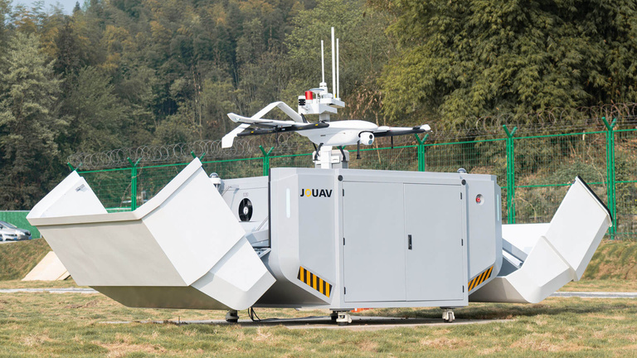
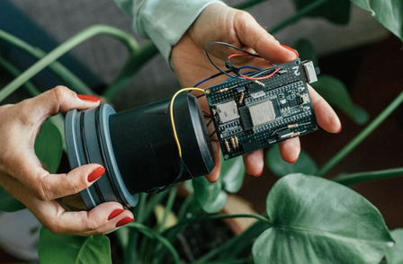
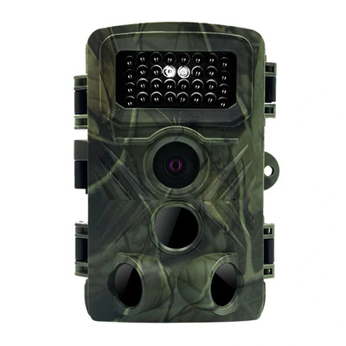
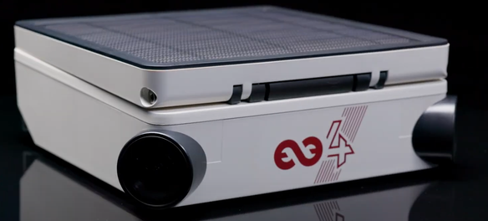
Exploring Alternatives
Basic Fit
Autonomous drone
Wide area of observation
ENAC constraints and weather damages
Turbidity sensors
Autonomous drone
Direct measurement and night-time operation
Variable Riverbed and vulnerability
Turbidity sensor
Infra Red camera
Night operation
High power consumption
RGB camera
Infrared camera
Low power and non-invasive solution
Only day-time operations
Tikee4X RGB camera
9
Notes:
Introducing ALSense — a platform designed to transform complex clinical data into clear, actionable insights.
ALSense was built with clinicians in mind: simple, intuitive, and immediately usable.
The user can upload data in just a few steps, without manual preprocessing or subjective interpretation.
From that moment on, the system takes over — analyzing the signal automatically and objectively. This is where ALSense begins to differentiate itself: by removing variability and uncertainty from the very first interaction

Slide 10
The SENTINEL System
Basic Fit
RGB IMAGING SYSTEM
POWER GENERATION SYSTEM
ENERGY MANAGEMENT SYSTEM
DATA ANALYSIS
PIPELINE
INFORMATION SYSTEM
MECHANICAL SYSTEM
10
Notes:
Introducing ALSense — a platform designed to transform complex clinical data into clear, actionable insights.
ALSense was built with clinicians in mind: simple, intuitive, and immediately usable.
The user can upload data in just a few steps, without manual preprocessing or subjective interpretation.
From that moment on, the system takes over — analyzing the signal automatically and objectively. This is where ALSense begins to differentiate itself: by removing variability and uncertainty from the very first interaction

Slide 11
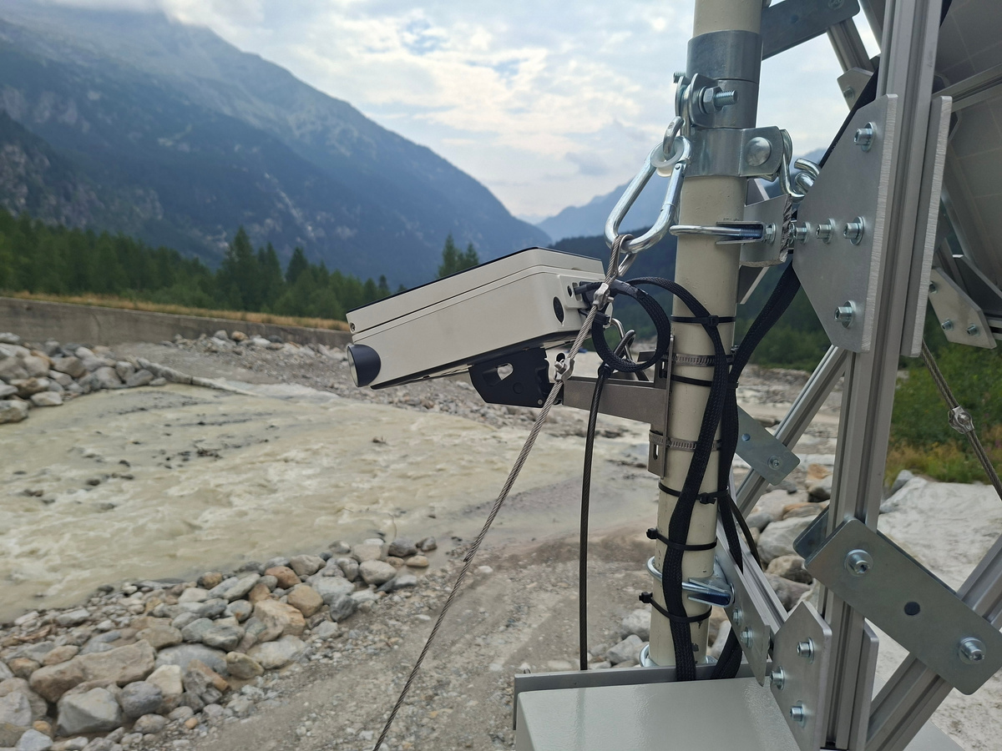
RGB Imaging
Basic Fit
Fast acquisition interval
  15 minutes interval
  Changes in water wurbidity evaluation
High resolution
  On ground resolution of 7.7 mm/px
  Small water stream identification
  Watery multiple pixels clusters
Wide FOV
  Full river observation - 16 m
  220° horizontal FOV
Optical monitoring system facing the rivrbed
Key takeaway:
The optical monitoring systems grants sufficient frequency of acquisition, resolution and field of view
11
Notes:
Introducing ALSense — a platform designed to transform complex clinical data into clear, actionable insights.
ALSense was built with clinicians in mind: simple, intuitive, and immediately usable.
The user can upload data in just a few steps, without manual preprocessing or subjective interpretation.
From that moment on, the system takes over — analyzing the signal automatically and objectively. This is where ALSense begins to differentiate itself: by removing variability and uncertainty from the very first interaction

Slide 12
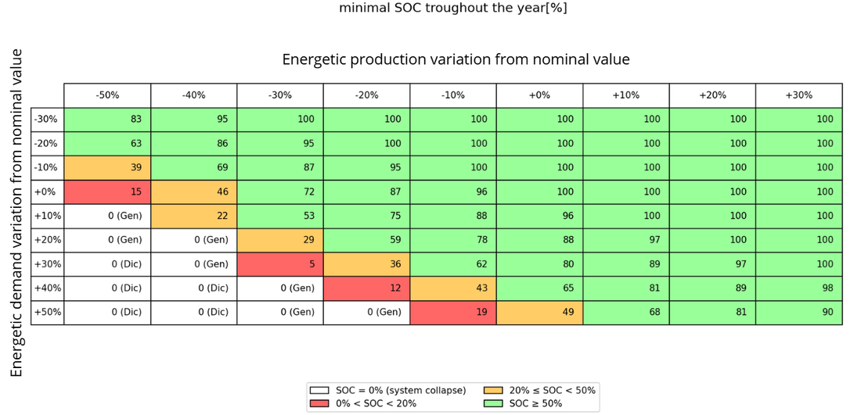
Energy Autonomy
Basic Fit
Solar Radiation
Power demand / solution:
Simulated autonomy:
  6.16 Wh/day estimated power consumption
  20 W external solar panel ( +4 W integrated)
  144 Wh external battery (+92 Wh integrated)
  38 days without power production
Solar Panel
MPPT Charge Regulator
LiFePO₄ Battery
Camera and Electronics
Logical scheme of power distribution across the electrical systems
Key takeaway:
Thorough extensive energy simulations the power demand was numerically verified and satisfied
12
Notes:
Introducing ALSense — a platform designed to transform complex clinical data into clear, actionable insights.
ALSense was built with clinicians in mind: simple, intuitive, and immediately usable.
The user can upload data in just a few steps, without manual preprocessing or subjective interpretation.
From that moment on, the system takes over — analyzing the signal automatically and objectively. This is where ALSense begins to differentiate itself: by removing variability and uncertainty from the very first interaction

Slide 13
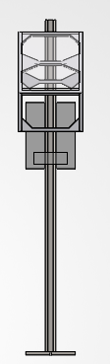
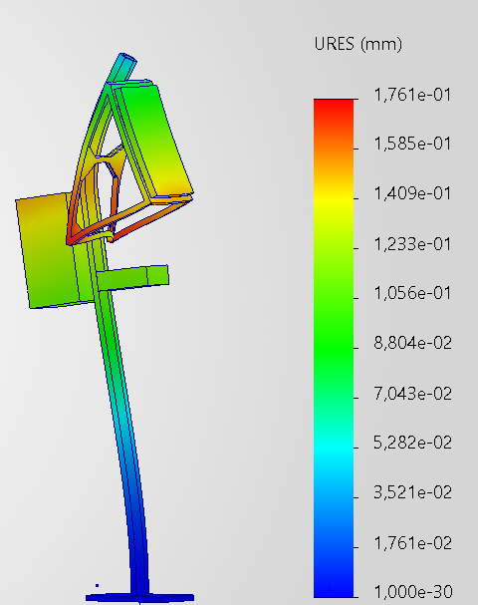
Mechanical Design
Basic Fit
Robust
  Resistant to 3x wind loads experienced
Stable
  Tensioned guy-wires reducing lateral displacement
  Reduction in acquired images variability
Lightweight
  Commercially available components
  Supported by 5 cm diameter pole
Numerically validated
Static monitoring solution’s model (left), displacement representation with scale under 50 m/s winds (right)
Key takeaway:
The mechanical support has been tested to withstand loads 3× higher than the historical maximum, ensuring sufficient camera stability.
13
Notes:
Introducing ALSense — a platform designed to transform complex clinical data into clear, actionable insights.
ALSense was built with clinicians in mind: simple, intuitive, and immediately usable.
The user can upload data in just a few steps, without manual preprocessing or subjective interpretation.
From that moment on, the system takes over — analyzing the signal automatically and objectively. This is where ALSense begins to differentiate itself: by removing variability and uncertainty from the very first interaction

Slide 14
Remote Communication
Basic Fit
Automatic image upload
Tikee4X camera
  Single image connection and transmission
  Tempestive data retrieval
LTE communication
Remote data availability
Cloud server
  No routine phisical data retrieval
  Cost reduction and efficiency improvements
Internet communication access
Automatic data analysis
  ML pipeline
  Quantitative data extraction
Research laboratory
Key takeaway:
Using a SIM card the monitoring station transmit each image to a remote server through mobile network coverage
14
Notes:
Introducing ALSense — a platform designed to transform complex clinical data into clear, actionable insights.
ALSense was built with clinicians in mind: simple, intuitive, and immediately usable.
The user can upload data in just a few steps, without manual preprocessing or subjective interpretation.
From that moment on, the system takes over — analyzing the signal automatically and objectively. This is where ALSense begins to differentiate itself: by removing variability and uncertainty from the very first interaction

Slide 15
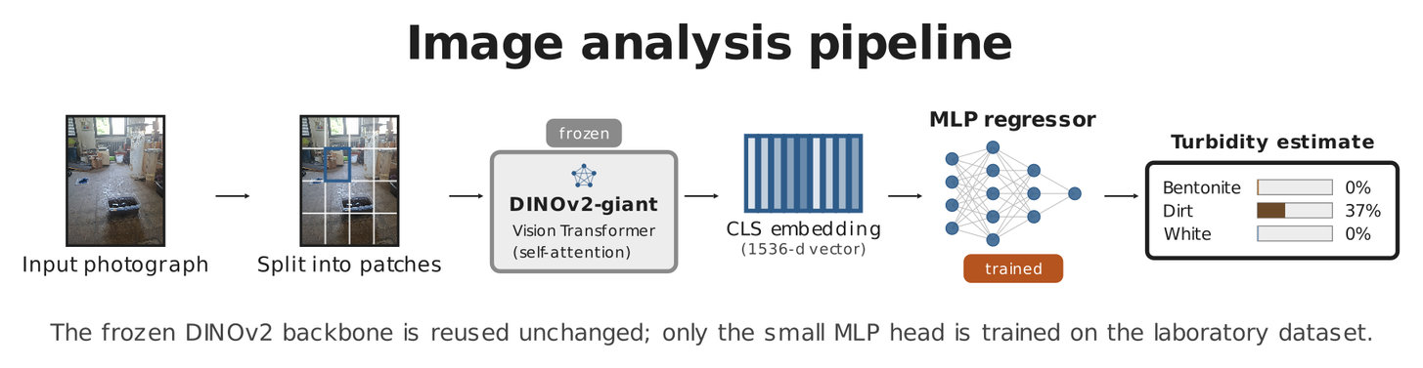
Machine Learning Pipeline
Basic Fit
Acquired RGB images
Input
Remote server
DINOv2
Regression model
Laboratory validated
Results:
Turbidity estimate
  93.2% material identification accuracy
  7% concentration Mean Absolute Error (MAE)
Output
Suspended sediment related information
Key takeaway:
AI automatically extract quantitative information about water turbidity from images
15
Notes:
Introducing ALSense — a platform designed to transform complex clinical data into clear, actionable insights.
ALSense was built with clinicians in mind: simple, intuitive, and immediately usable.
The user can upload data in just a few steps, without manual preprocessing or subjective interpretation.
From that moment on, the system takes over — analyzing the signal automatically and objectively. This is where ALSense begins to differentiate itself: by removing variability and uncertainty from the very first interaction

Slide 16
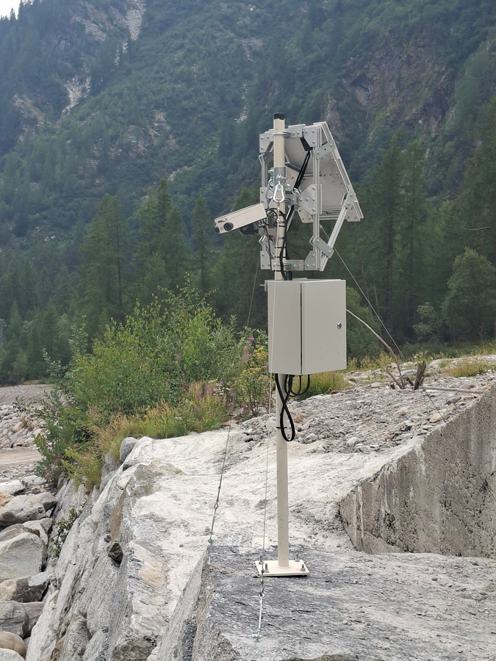
System Integration
Basic Fit
Subsystem integration
  Mechanical, electrical and imaging ubsystem integration
  On-site installation
Camera installation and configuration
  Lenses placement for site observation
  Camera parameters configuration
Power generation connection
  Power source and storage connection
  Recharge and devices communication verified
Initial field commissioning
Key takeaway:
After design, development and integration the system can be commissioned
16
Notes:
Introducing ALSense — a platform designed to transform complex clinical data into clear, actionable insights.
ALSense was built with clinicians in mind: simple, intuitive, and immediately usable.
The user can upload data in just a few steps, without manual preprocessing or subjective interpretation.
From that moment on, the system takes over — analyzing the signal automatically and objectively. This is where ALSense begins to differentiate itself: by removing variability and uncertainty from the very first interaction

Slide 17
Validation and Performance
Basic Fit
Optical
Mechanical
Target coverage
Target resolution
Acquisition configuration
Static analysis
Modal analysis
Harmonic response analysis
Energy
Machine Learning
Energy budget
PV / storage sizing
Autonomous operation design
Laboratory validation
Field calibration
Key takeaway:
The integrated design satisfies the defined system requirements while
long-term field operation and in-situ ML calibration remain to be validated.
17
Notes:
Introducing ALSense — a platform designed to transform complex clinical data into clear, actionable insights.
ALSense was built with clinicians in mind: simple, intuitive, and immediately usable.
The user can upload data in just a few steps, without manual preprocessing or subjective interpretation.
From that moment on, the system takes over — analyzing the signal automatically and objectively. This is where ALSense begins to differentiate itself: by removing variability and uncertainty from the very first interaction

Slide 18
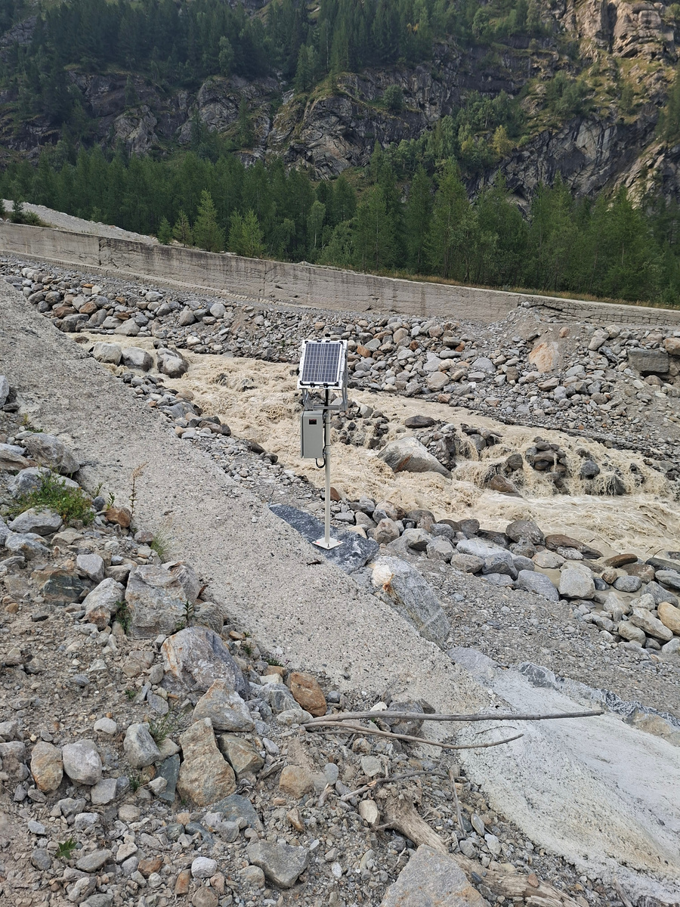
Achievements
Basic Fit
Continous monitoring
  Fixed 15 minutes acquisition interval
  No sporadic expeditions needed
  Automatic data retrieval
Reliable data
  Fixed point of view
  Automatic compensation of illumination
  Consistent data acquisition throughout the year
SENTINEL establishes a technical foundation for autonomous long-term monitoring of sediment dynamics in glacier-fed Alpine environments.
18
Notes:
Introducing ALSense — a platform designed to transform complex clinical data into clear, actionable insights.
ALSense was built with clinicians in mind: simple, intuitive, and immediately usable.
The user can upload data in just a few steps, without manual preprocessing or subjective interpretation.
From that moment on, the system takes over — analyzing the signal automatically and objectively. This is where ALSense begins to differentiate itself: by removing variability and uncertainty from the very first interaction

Slide 19
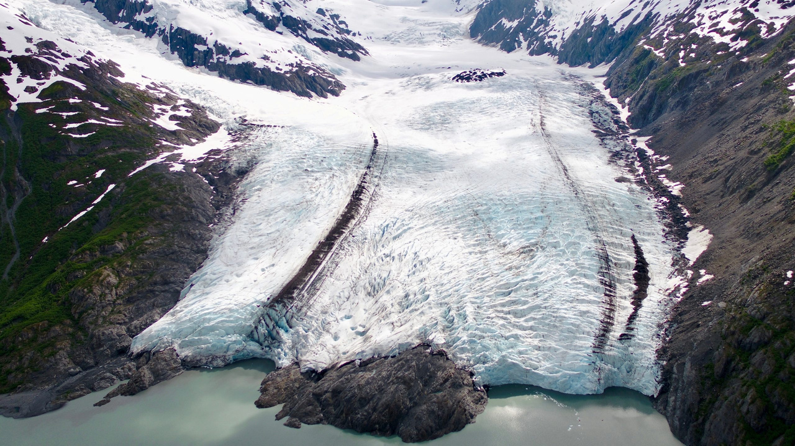
Future Applications
Basic Fit
Continuous and diffused monitoring
  Subsystem organizaztion allows adaptation to different environments with small adjustments
Predictive algorithms
  Solution tested in laboratory conditions
  Field validation required
The project represents the base for future developments and opens to the pioneering of a new paradigm to acquire insights in climate change and its consequences.
19
Notes:
Introducing ALSense — a platform designed to transform complex clinical data into clear, actionable insights.
ALSense was built with clinicians in mind: simple, intuitive, and immediately usable.
The user can upload data in just a few steps, without manual preprocessing or subjective interpretation.
From that moment on, the system takes over — analyzing the signal automatically and objectively. This is where ALSense begins to differentiate itself: by removing variability and uncertainty from the very first interaction

Slide 20
THANK YOU!
  Simone Maria Mazzola
  Paolo Ginefra
  Matteo Gandini
  Jacopo Sampò
  Shahd Abdelaziz
  Aronne Moltrasio
  Nicolò Dalmazzo
Professors:
  Carlo De Michele
  Alberto bianchi
  Livio pinto
  Alberto Cina
Notes:
"How confident are you in this diagnosis?"
What is a simple routine exchange between two doctors, for the patient could mean months of waiting or uncertainty.
In ALS - Amiotrophic Lateral Scleroris- diagnosis, the stakes couldn't be higher, but the problem isn't neurologist expertise. The problem is the signal itself.

